Slide 1
CONSTRAINT SATISFACTION PROBLEMS
Course Code: CSC4226
Course Title: Artificial Intelligence and Expert System
Dept. of Computer Science
Faculty of Science and Technology
Lecture No: | Eight (7) | Week No: | Eight (8) | Semester:
Lecturer: | SAZIA SHARMIN

Slide 2
Lecture Outline
Defining CSP
Varieties of CSPs
Backtracking Search for CSPs
Forward Checking
Constraint Propagation
Heuristics for CSP
Problem Structure

Slide 3
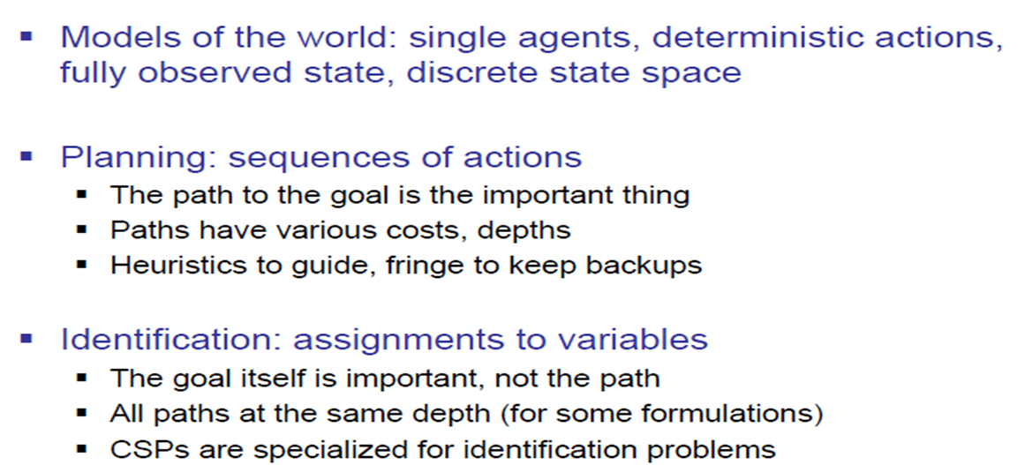
What is Search For?

Slide 4
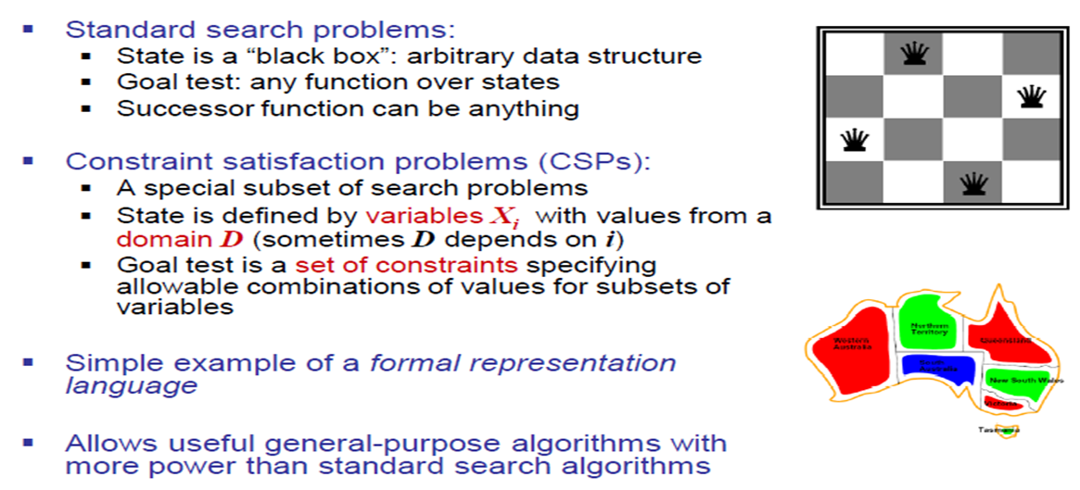
Constraint Satisfaction Problems

Slide 5
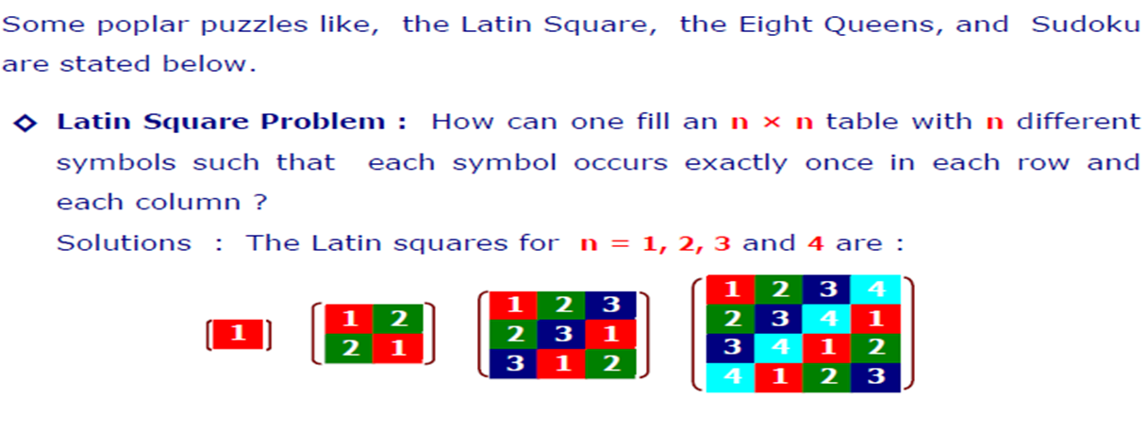
Example of CSPs

Slide 6
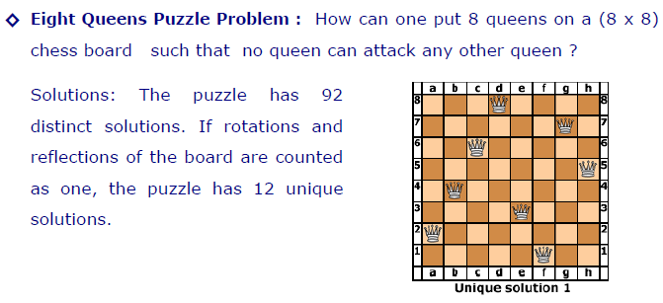
Example of CSPs

Slide 7
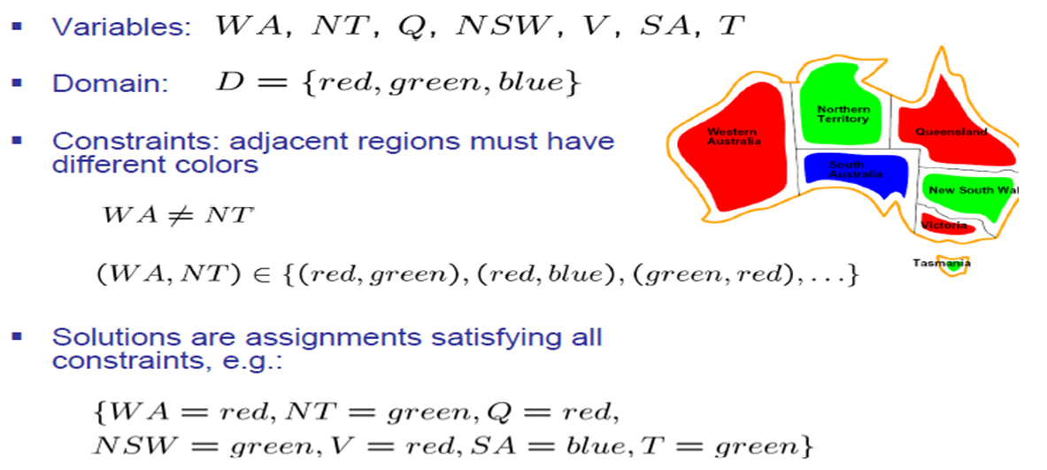
Example CSP: Map Coloring

Slide 8
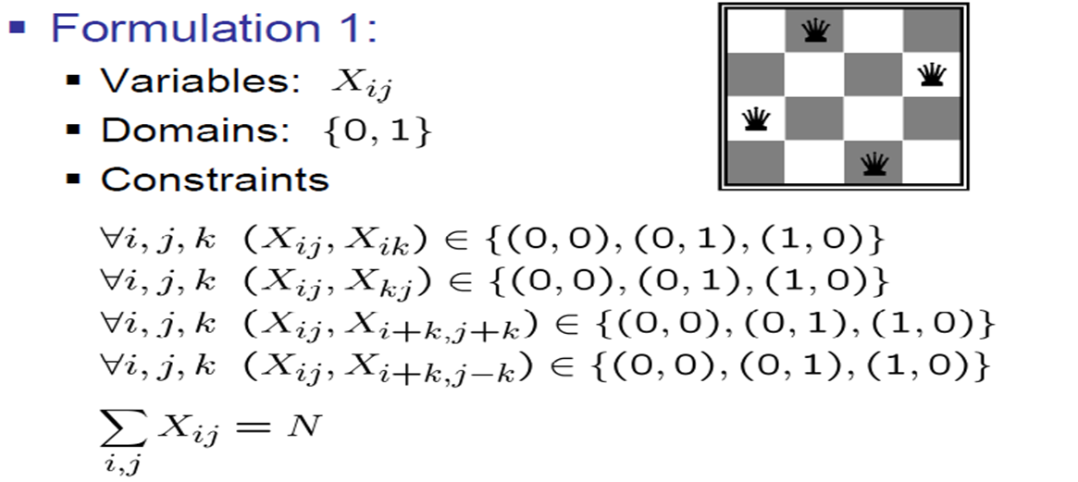
Example: N-Queens

Slide 9
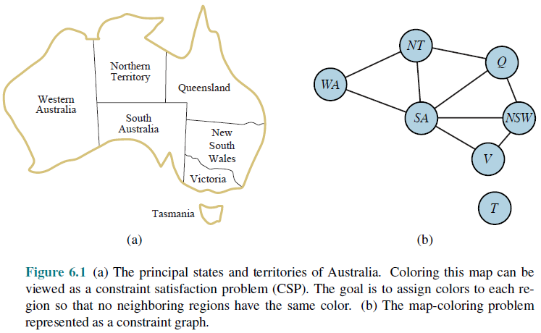
Constraint Graph

Slide 10
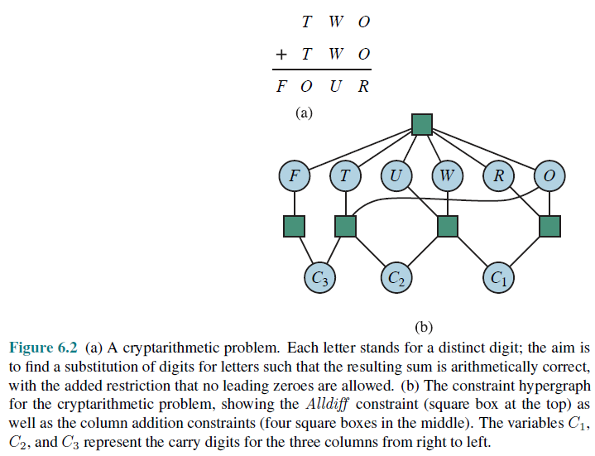
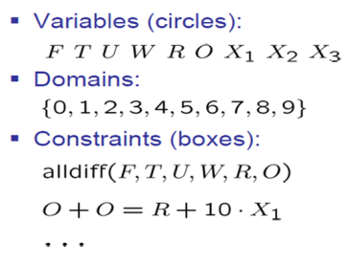
Example CSP: Cryptarithmetic

Slide 11
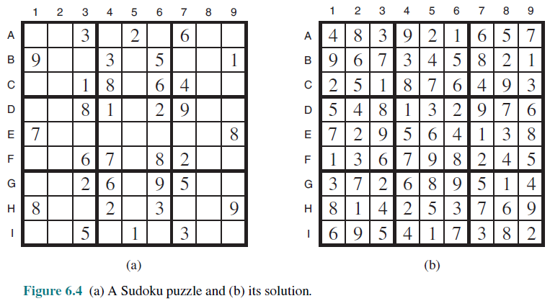
Example: Sudoku

Slide 12
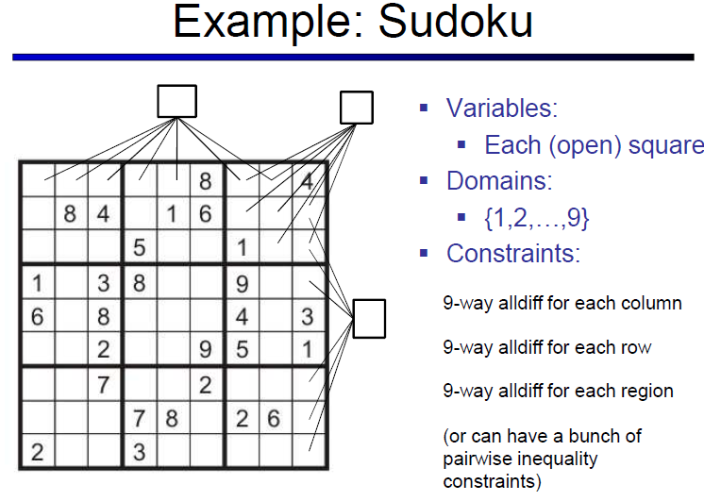
Topic Heading..

Slide 13
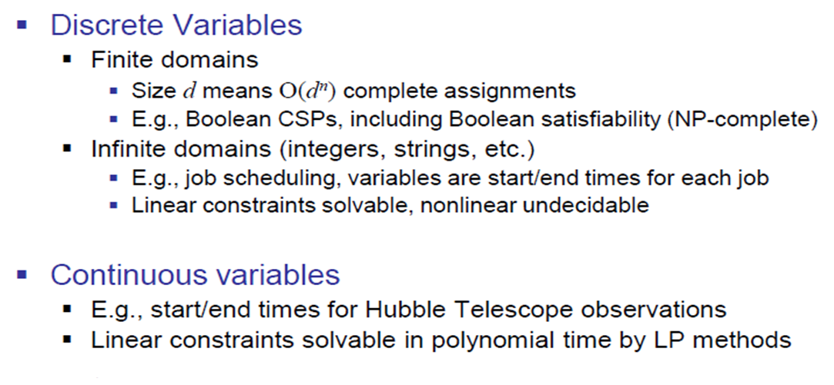
Varieties of CSPs

Slide 14
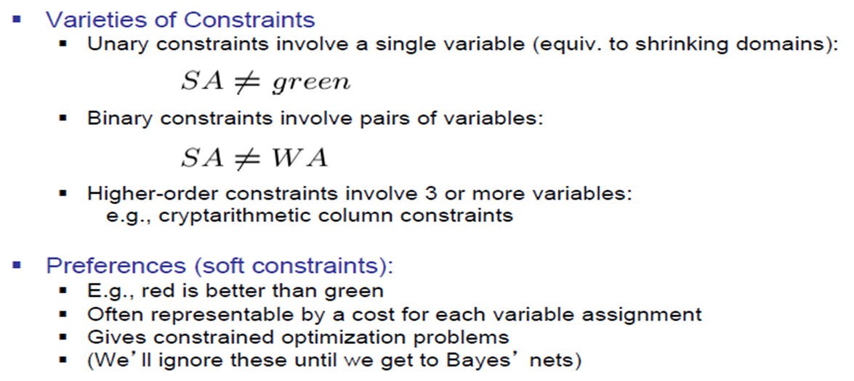
Varieties of Constraints

Slide 15
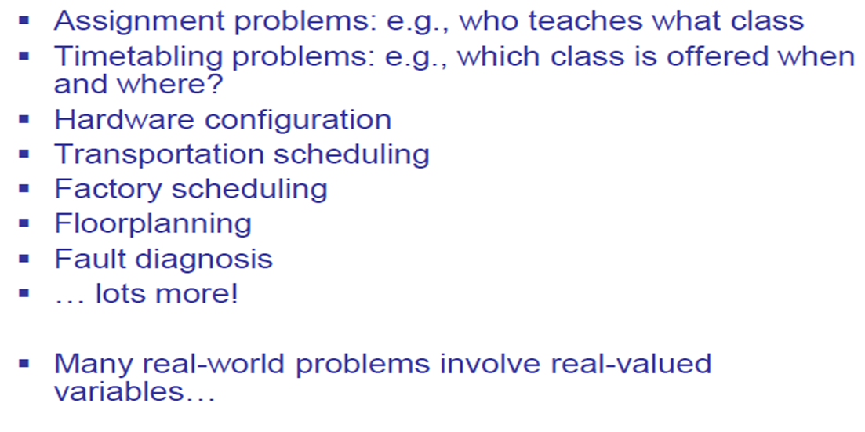
Real World CSPs

Slide 16
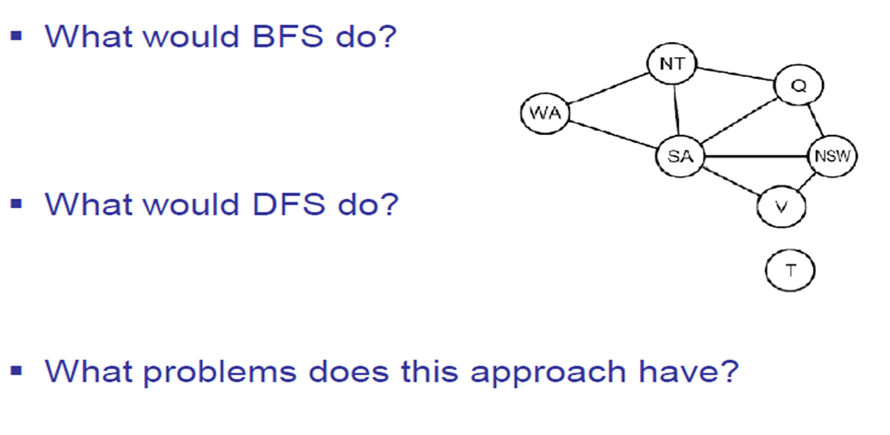
Search Methods

Slide 17
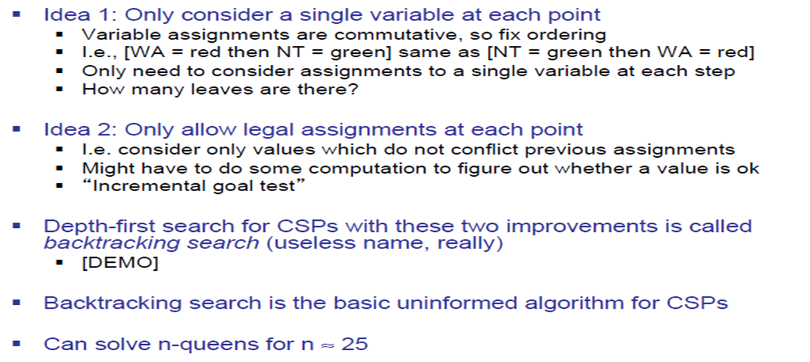
Backtracking Search

Slide 18
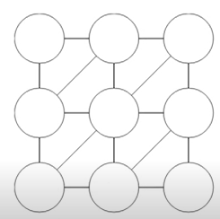
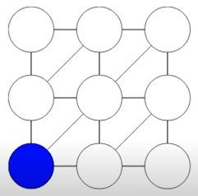
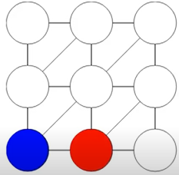
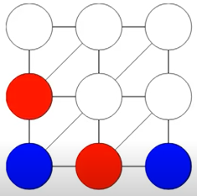
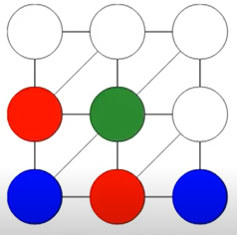
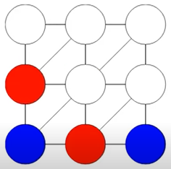
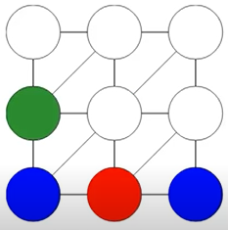
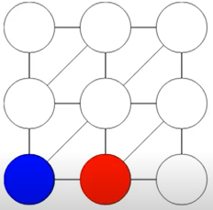
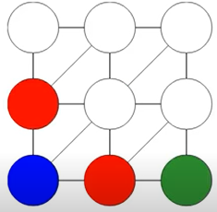
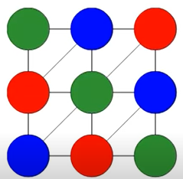
Demonstration
Assigning Value from Domain = { Blue, Red, Green} To Each Variables (circles)
from Left to Right Order
NO COLOR TO ASSIGN NEXT. BACKTRACK

Slide 19
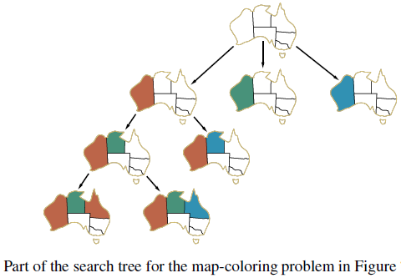
Backtracking Example

Slide 20
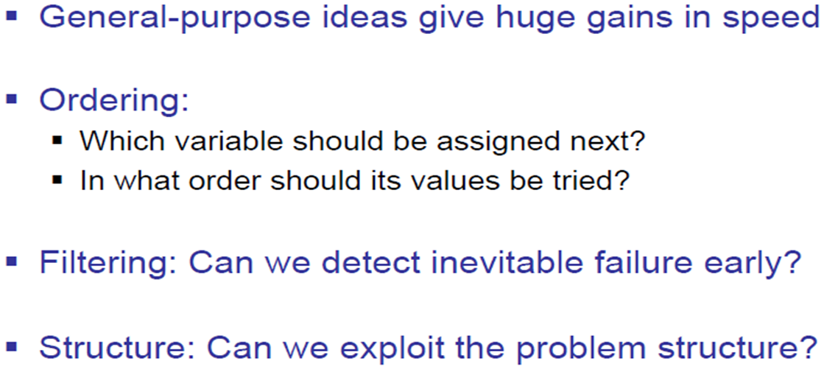
Improving Backtracking

Slide 21
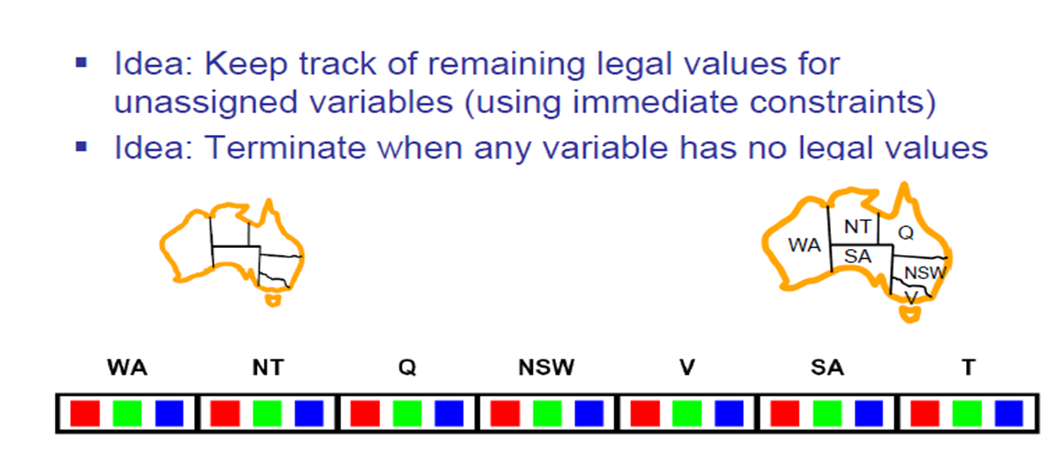
Filtering: Forward Checking

Slide 22
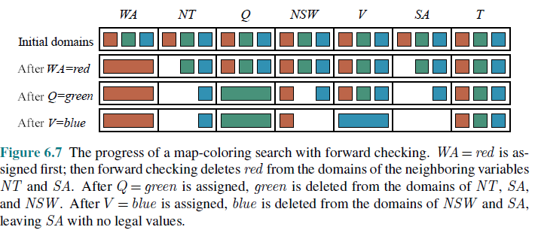
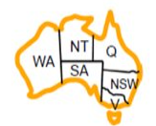
Progress of Map Coloring

Slide 23
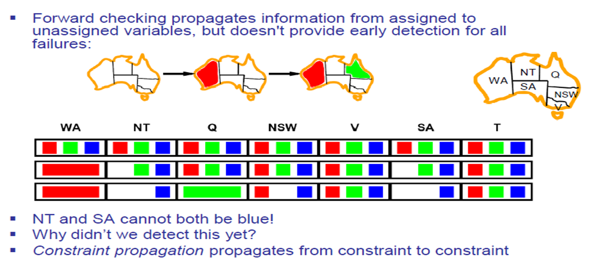
Filtering: Constraint Propagation

Slide 24
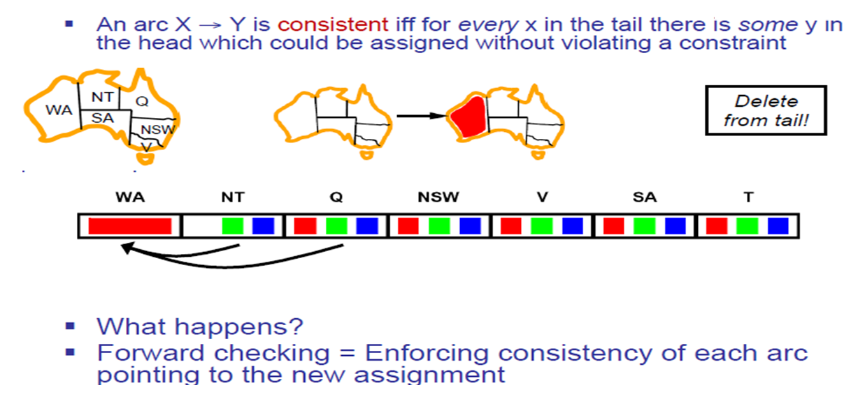
Consistency of An Arc

Slide 25
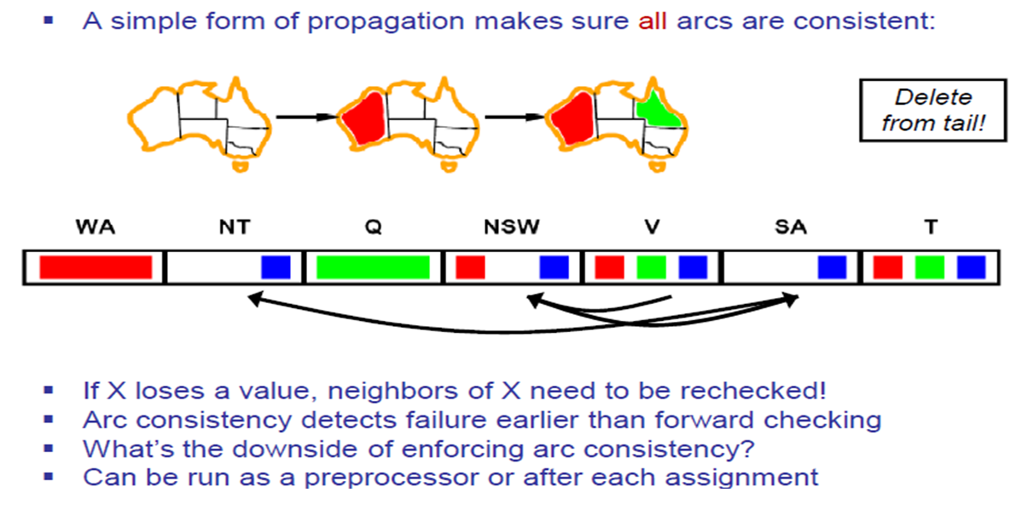
Arc Consistency of a CSP

Slide 26
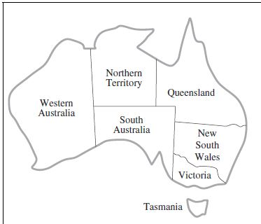
Arc Consistency of a CSP
Variable
WA = {R, G, B}
NT= {R, G, B}
Q= {R, G, B}
NSW= {R, G, B}
V = {R, G, B}
SA= {R, G, B}
T= {R, G, B}
Constraints
SA≠WA
SA≠NT
SA≠Q
SA≠NSW
SA≠V
WA≠NT
NT≠Q
Q≠NSW
NSW≠V
Constraints
WA≠SA
NT≠SA
Q≠SA
NSW≠SA
V≠SA
NT≠WA
Q≠NT
NSW≠Q
V≠NSW

Slide 27
Arc Consistency of a CSP
Variable
WA = {R}
NT= {R, G, B}
Q= {R, G, B}
NSW= {R, G, B}
V = {R, G, B}
SA= {R, G, B}
T= {R, G, B}
Constraints
SA≠WA
SA≠NT
SA≠Q
SA≠NSW
SA≠V
WA≠NT
NT≠Q
Q≠NSW
NSW≠V
Constraints
WA≠SA
NT≠SA
Q≠SA
NSW≠SA
V≠SA
NT≠WA
Q≠NT
NSW≠Q
V≠NSW

Slide 28
Arc Consistency of a CSP
Variable
WA = {R}
NT= {R, G, B}
Q= {R, G, B}
NSW= {R, G, B}
V = {R, G, B}
SA= {R, G, B}
T= {R, G, B}
Constraints
SA≠WA
SA≠NT
SA≠Q
SA≠NSW
SA≠V
WA≠NT
NT≠Q
Q≠NSW
NSW≠V
Constraints
WA≠SA
NT≠SA
Q≠SA
NSW≠SA
V≠SA
NT≠WA
Q≠NT
NSW≠Q
V≠NSW

Slide 29
Arc Consistency of a CSP
Variable
WA = {R}
NT= {R, G, B}
Q= {R, G, B}
NSW= {R, G, B}
V = {R, G, B}
SA= {G, B}
T= {R, G, B}
Constraints
SA≠WA
SA≠NT
SA≠Q
SA≠NSW
SA≠V
WA≠NT
NT≠Q
Q≠NSW
NSW≠V
Constraints
WA≠SA
NT≠SA
Q≠SA
NSW≠SA
V≠SA
NT≠WA
Q≠NT
NSW≠Q
V≠NSW

Slide 30
Arc Consistency of a CSP
Variable
WA = {R}
NT= {R, G, B}
Q= {R, G, B}
NSW= {R, G, B}
V = {R, G, B}
SA= {G, B}
T= {R, G, B}
Constraints
SA≠WA
SA≠NT
SA≠Q
SA≠NSW
SA≠V
WA≠NT
NT≠Q
Q≠NSW
NSW≠V
Constraints
WA≠SA
NT≠SA
Q≠SA
NSW≠SA
V≠SA
NT≠WA
Q≠NT
NSW≠Q
V≠NSW

Slide 31
Arc Consistency of a CSP
Variable
WA = {R}
NT= {R, G, B}
Q= {R, G, B}
NSW= {R, G, B}
V = {R, G, B}
SA= {G, B}
T= {R, G, B}
Constraints
SA≠WA
SA≠NT
SA≠Q
SA≠NSW
SA≠V
WA≠NT
NT≠Q
Q≠NSW
NSW≠V
Constraints
WA≠SA
NT≠SA
Q≠SA
NSW≠SA
V≠SA
NT≠WA
Q≠NT
NSW≠Q
V≠NSW

Slide 32
Arc Consistency of a CSP
Variable
WA = {R}
NT= {G, B}
Q= {R, G, B}
NSW= {R, G, B}
V = {R, G, B}
SA= {G, B}
T= {R, G, B}
Constraints
SA≠WA
SA≠NT
SA≠Q
SA≠NSW
SA≠V
WA≠NT
NT≠Q
Q≠NSW
NSW≠V
Constraints
WA≠SA
NT≠SA
Q≠SA
NSW≠SA
V≠SA
NT≠WA
Q≠NT
NSW≠Q
V≠NSW

Slide 33
Arc Consistency of a CSP
Variable
WA = {R}
NT= {G, B}
Q= {R, G, B}
NSW= {R, G, B}
V = {R, G, B}
SA= {G, B}
T= {R, G, B}
Constraints
SA≠WA
SA≠NT
SA≠Q
SA≠NSW
SA≠V
WA≠NT
NT≠Q
Q≠NSW
NSW≠V
Constraints
WA≠SA
NT≠SA
Q≠SA
NSW≠SA
V≠SA
NT≠WA
Q≠NT
NSW≠Q
V≠NSW

Slide 34
Arc Consistency of a CSP
Variable
WA = {R}
NT= {G, B}
Q= {R, G, B}
NSW= {R, G, B}
V = {R, G, B}
SA= {G, B}
T= {R, G, B}
Constraints
SA≠WA
SA≠NT
SA≠Q
SA≠NSW
SA≠V
WA≠NT
NT≠Q
Q≠NSW
NSW≠V
Constraints
WA≠SA
NT≠SA
Q≠SA
NSW≠SA
V≠SA
NT≠WA
Q≠NT
NSW≠Q
V≠NSW

Slide 35
Arc Consistency of a CSP
Variable
WA = {R}
NT= {G, B}
Q= {R, G, B}
NSW= {R, G, B}
V = {R, G, B}
SA= {G, B}
T= {R, G, B}
Constraints
SA≠WA
SA≠NT
SA≠Q
SA≠NSW
SA≠V
WA≠NT
NT≠Q
Q≠NSW
NSW≠V
Constraints
WA≠SA
NT≠SA
Q≠SA
NSW≠SA
V≠SA
NT≠WA
Q≠NT
NSW≠Q
V≠NSW

Slide 36
Arc Consistency of a CSP
Variable
WA = {R}
NT= {G, B}
Q= {G}
NSW= {R, G, B}
V = {R, G, B}
SA= {G, B}
T= {R, G, B}
Constraints
SA≠WA
SA≠NT
SA≠Q
SA≠NSW
SA≠V
WA≠NT
NT≠Q
Q≠NSW
NSW≠V
Constraints
WA≠SA
NT≠SA
Q≠SA
NSW≠SA
V≠SA
NT≠WA
Q≠NT
NSW≠Q
V≠NSW

Slide 37
Arc Consistency of a CSP
Variable
WA = {R}
NT= {G, B}
Q= {G}
NSW= {R, G, B}
V = {R, G, B}
SA= {B}
T= {R, G, B}
Constraints
SA≠WA
SA≠NT
SA≠Q
SA≠NSW
SA≠V
WA≠NT
NT≠Q
Q≠NSW
NSW≠V
Constraints
WA≠SA
NT≠SA
Q≠SA
NSW≠SA
V≠SA
NT≠WA
Q≠NT
NSW≠Q
V≠NSW

Slide 38
Arc Consistency of a CSP
Variable
WA = {R}
NT= {B}
Q= {G}
NSW= {R, G, B}
V = {R, G, B}
SA= {B}
T= {R, G, B}
Constraints
SA≠WA
SA≠NT
SA≠Q
SA≠NSW
SA≠V
WA≠NT
NT≠Q
Q≠NSW
NSW≠V
Constraints
WA≠SA
NT≠SA
Q≠SA
NSW≠SA
V≠SA
NT≠WA
Q≠NT
NSW≠Q
V≠NSW

Slide 39
Arc Consistency of a CSP
Variable
WA = {R}
NT= {B}
Q= {G}
NSW= {R, G, B}
V = {R, G, B}
SA= {B}
T= {R, G, B}
Constraints
SA≠WA
SA≠NT
SA≠Q
SA≠NSW
SA≠V
WA≠NT
NT≠Q
Q≠NSW
NSW≠V
Constraints
WA≠SA
NT≠SA
Q≠SA
NSW≠SA
V≠SA
NT≠WA
Q≠NT
NSW≠Q
V≠NSW

Slide 40
Arc Consistency of a CSP
Variable
WA = {R}
NT= {B}
Q= {G}
NSW= {R, B}
V = {R, G, B}
SA= {B}
T= {R, G, B}
Constraints
SA≠WA
SA≠NT
SA≠Q
SA≠NSW
SA≠V
WA≠NT
NT≠Q
Q≠NSW
NSW≠V
Constraints
WA≠SA
NT≠SA
Q≠SA
NSW≠SA
V≠SA
NT≠WA
Q≠NT
NSW≠Q
V≠NSW

Slide 41
Arc Consistency of a CSP
Variable
WA = {R}
NT= {B}
Q= {G}
NSW= {R, B}
V = {R, G, B}
SA= {B}
T= {R, G, B}
Constraints
SA≠WA
SA≠NT
SA≠Q
SA≠NSW
SA≠V
WA≠NT
NT≠Q
Q≠NSW
NSW≠V
Constraints
WA≠SA
NT≠SA
Q≠SA
NSW≠SA
V≠SA
NT≠WA
Q≠NT
NSW≠Q
V≠NSW

Slide 42
Arc Consistency of a CSP
Variable
WA = {R}
NT= {B}
Q= {G}
NSW= {R, B}
V = {R, G, B}
SA= {B}
T= {R, G, B}
Constraints
SA≠WA
SA≠NT
SA≠Q
SA≠NSW
SA≠V
WA≠NT
NT≠Q
Q≠NSW
NSW≠V
Constraints
WA≠SA
NT≠SA
Q≠SA
NSW≠SA
V≠SA
NT≠WA
Q≠NT
NSW≠Q
V≠NSW

Slide 43
Arc Consistency of a CSP
Variable
WA = {R}
NT= {B}
Q= {G}
NSW= {R, B}
V = {R, G, B}
SA= {}
T= {R, G, B}
Constraints
SA≠WA
SA≠NT
SA≠Q
SA≠NSW
SA≠V
WA≠NT
NT≠Q
Q≠NSW
NSW≠V
Constraints
WA≠SA
NT≠SA
Q≠SA
NSW≠SA
V≠SA
NT≠WA
Q≠NT
NSW≠Q
V≠NSW

Slide 44
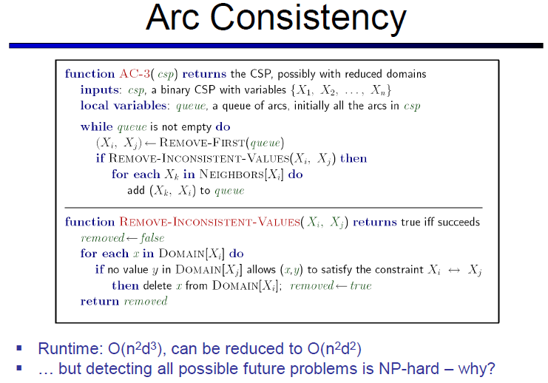
Topic Heading..

Slide 45
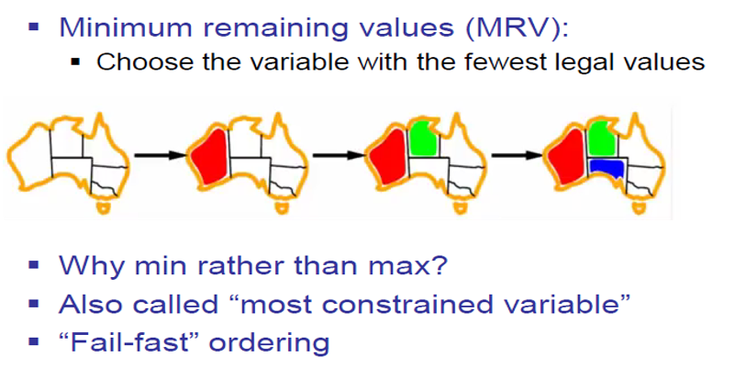
Ordering: Minimum Remaining Value

Slide 46
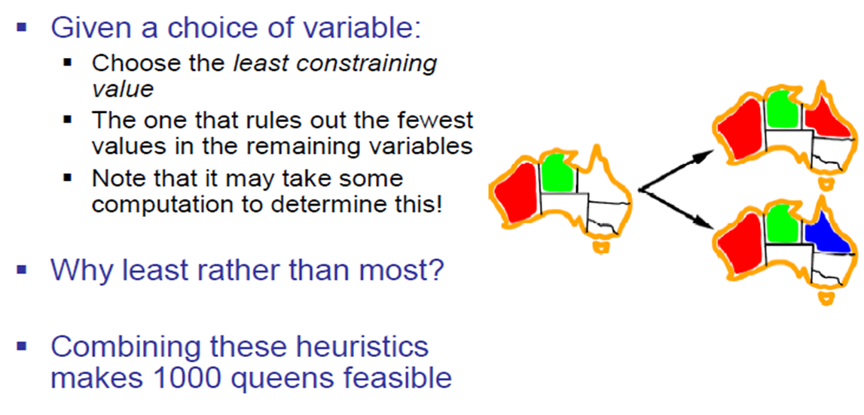
Ordering: Least Constraining Value

Slide 47
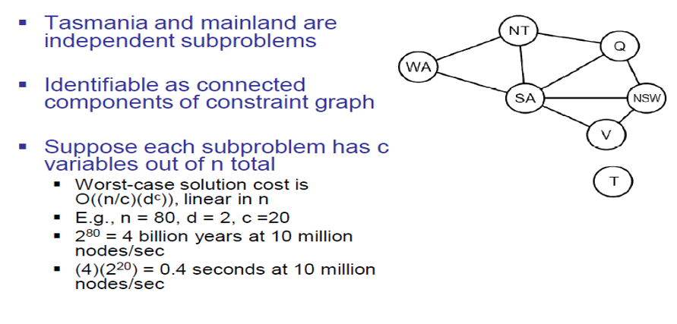
Problem Structure
Dividing a Boolean CSP with 80 variables into four sub problems reduces the worst-case solution time from the lifetime of the universe down to less than a second

Slide 48
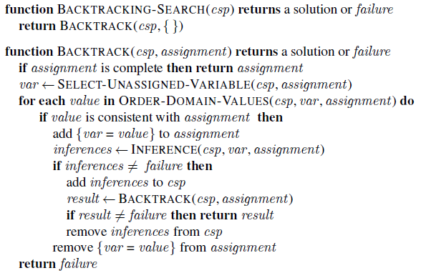
Backtracking Search

Slide 49
References
Chapter 6: Introduction , Pages 202-220
“Artificial Intelligence: A Modern Approach,” by Stuart J. Russell and Peter Norvig,

